Slide 1
第9章-4 激光器的应用

Slide 2
Applications of lasers

Slide 3
通信
半导体激光器：
波段、损耗
线宽: a few megahertz.
成本
Band | Description | Wavelength Range
O band | original | 1260 to 1360 nm
E band | extended | 1360 to 1460 nm
S band | short wavelengths | 1460 to 1530 nm
C band | conventional ("erbium window") | 1530 to 1565 nm
L band | long wavelengths | 1565 to 1625 nm
U band | ultralong wavelengths | 1625 to 1675 nm

Slide 4
A distributed feedback laser (DFB) is a type of single frequency laser diode.
DFB laser diodes do not use two discrete mirrors to form the optical cavity (as they are used in conventional laser designs). The grating acts as the wavelength selective element for at least one of the mirrors and provides the feedback, reflecting light back into the cavity to form the resonator. The grating is constructed so as to reflect only a narrow band of wavelengths, and thus produce a single longitudinal lasing mode. This is in contrast to a Fabry-Perot Laser, where the facets of the chip form the two mirrors and provide the feedback. In that case, the mirrors are broadband and either the laser functions at multiple longitudinal modes simultaneously or easily jumps between longitudinal modes.

Slide 5
激光加工
激光打标：YAG
激光焊接、切割：CO2
刻蚀：准分子193/157、飞秒
光致折射率变化：248
3D打印：热熔、双光子聚合
表面处理：钝化、去应力、镀膜

Slide 6
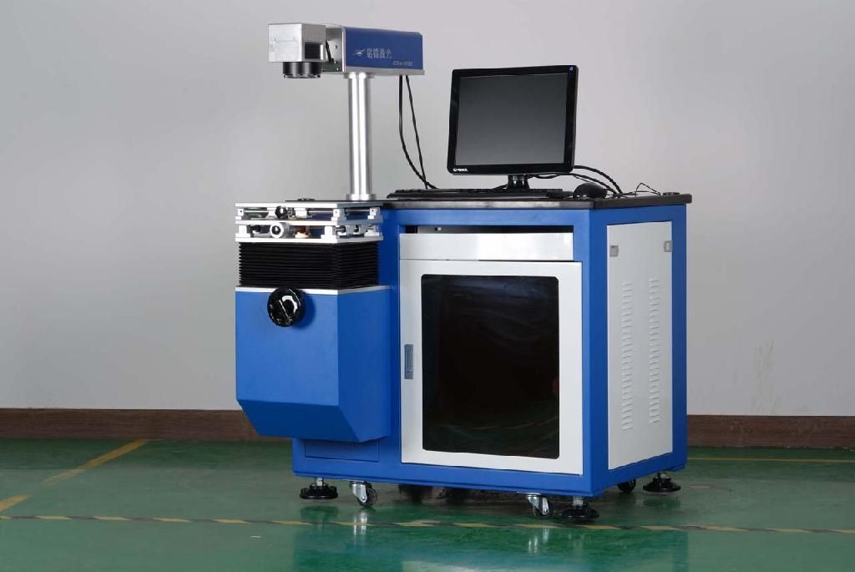
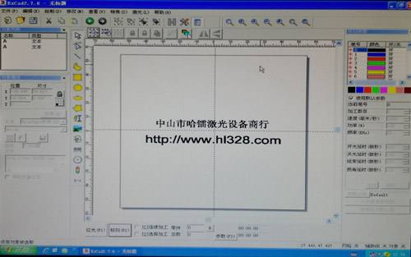
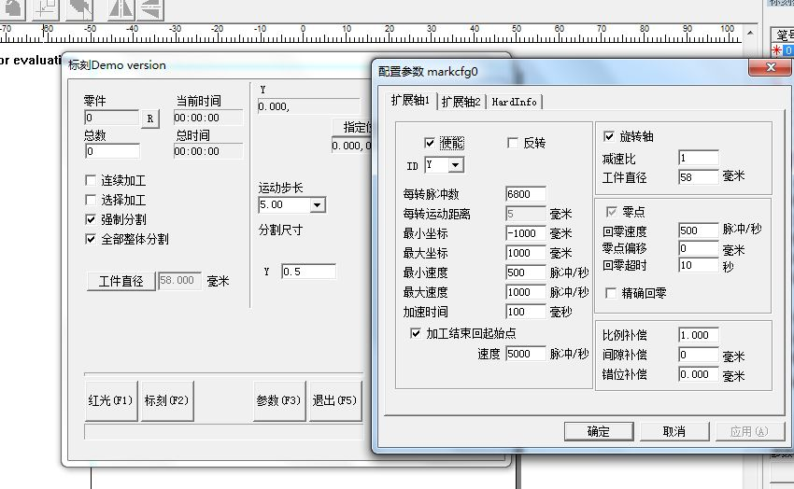
打标机

Slide 7
Power
Power | Use
1–5 mW | Laser pointers
5 mW | CD-ROM drive
5–10 mW | DVD player or DVD-ROM drive
100 mW | High-speed CD-RW burner
250 mW | Consumer 16× DVD-R burner
400 mW | Burning through a jewel case including disc within 4 seconds^{[66]}
 | DVD 24× dual-layer recording.^{[67]}
1 W | Green laser in current Holographic Versatile Disc prototype development
1–20 W | Output of the majority of commercially available solid-state lasers used for micro machining
30–100 W | Typical sealed CO₂ surgical lasers^{[68]}
100–3000 W | Typical sealed CO₂ lasers used in industrial laser cutting

Slide 8
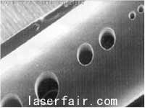
Wavelength
准分子193/157
SiO2: 4.x eV

Slide 9
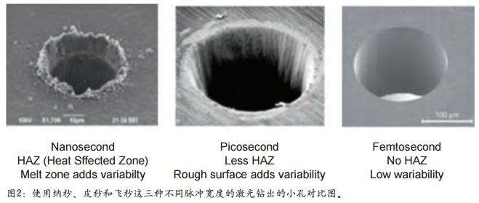
fs laser
热积累小

Slide 10
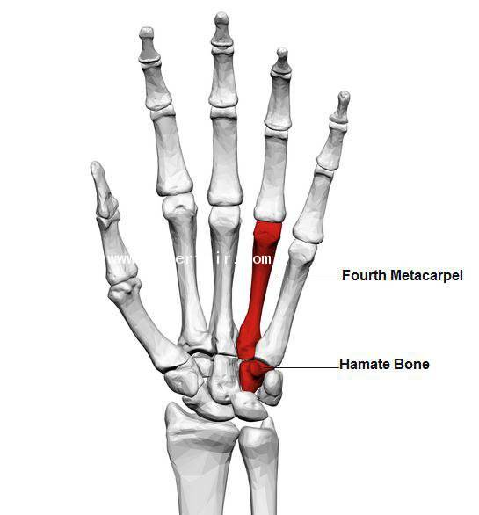
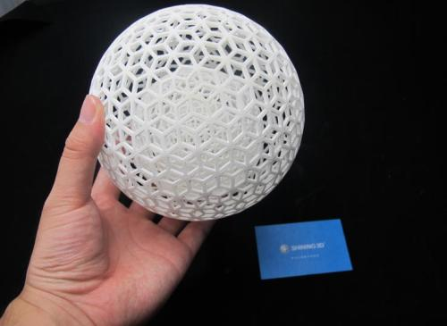
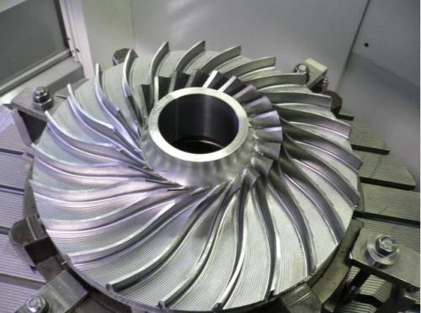
3D打印

Slide 11
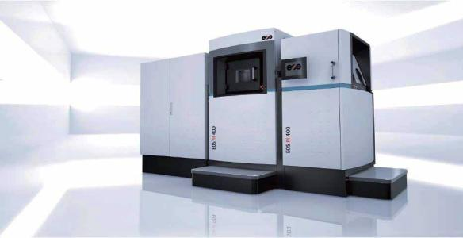
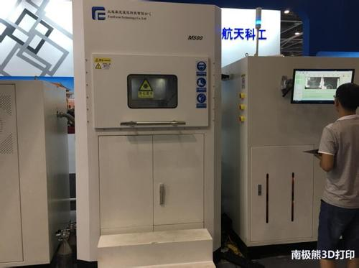
3D打印

Slide 12
传感
点式传感器：可调谐激光器
分布式传感器：拉曼泵浦激光器，窄线宽激光器
波段：红外传感
激光雷达

Slide 13
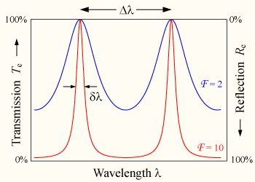
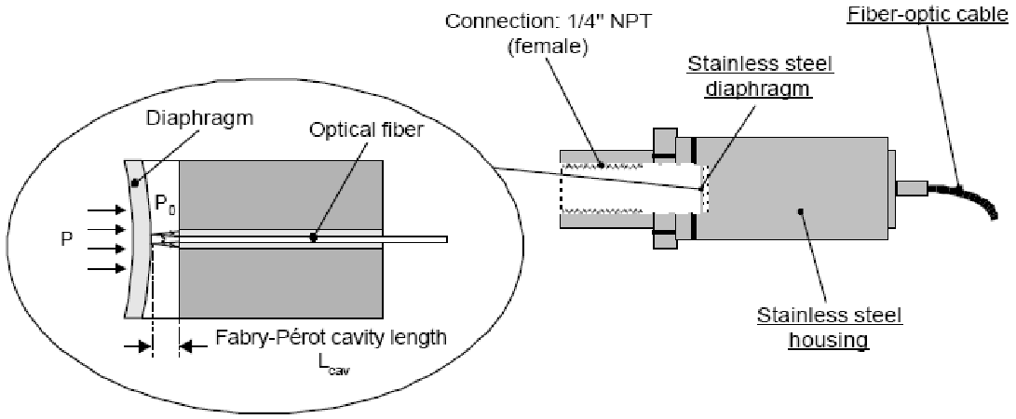
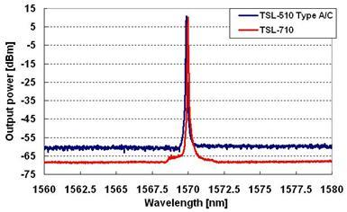
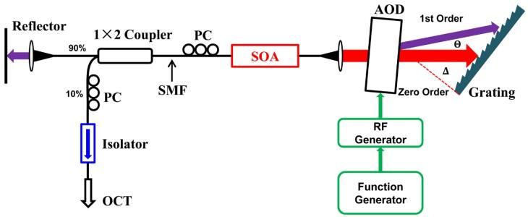

Slide 14
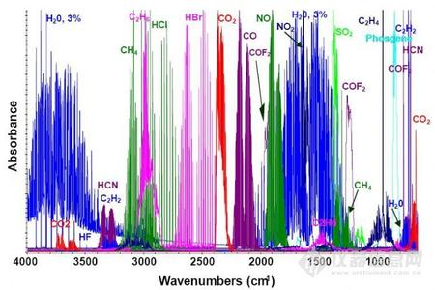

Slide 15
光谱分析
宽带光源
可调谐激光器
红外
光学频率梳/超快激光 (时间基准)

Slide 16
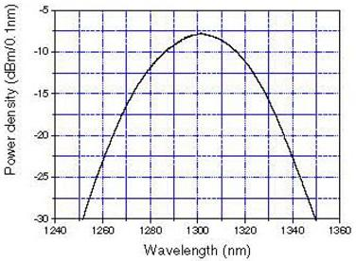
Broadband source

Slide 17
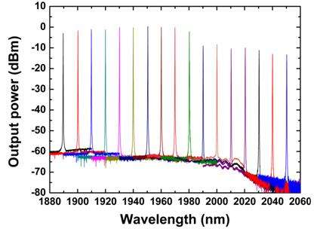
Tunable laser

Slide 18
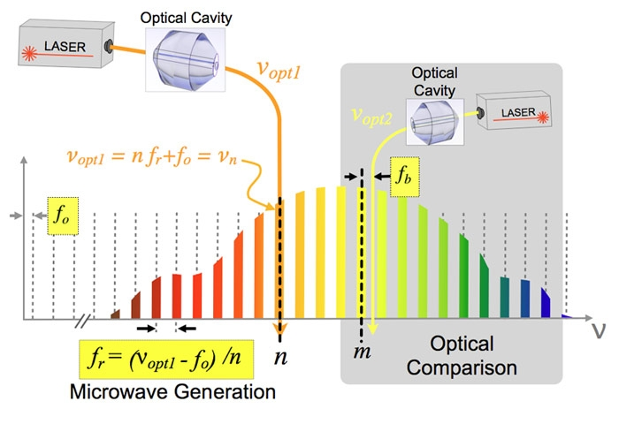
Optical frequency comb

Slide 19
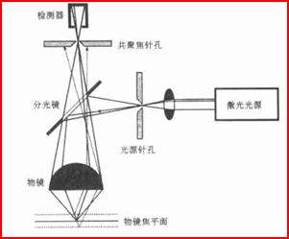
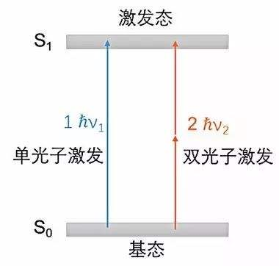
成像
传统显微镜：白光
激光共焦显微镜、多光子成像

Slide 20
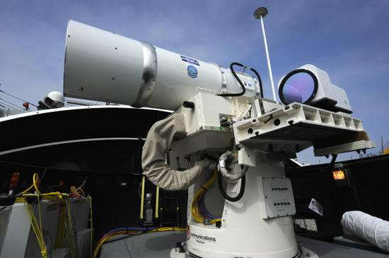
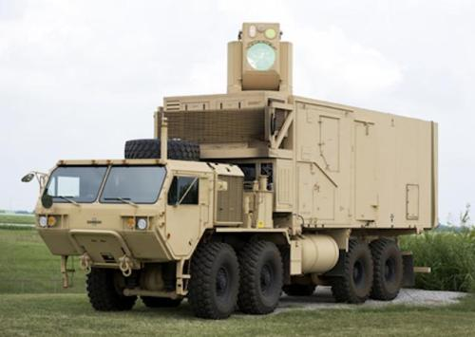
激光武器
致盲
热摧毁

Slide 21
制导、导航
激光陀螺
机械陀螺、光纤陀螺
加速度计、惯性导航

Slide 22
能源
惯性约束核聚变
NIF、ICF
神光系列

Slide 23
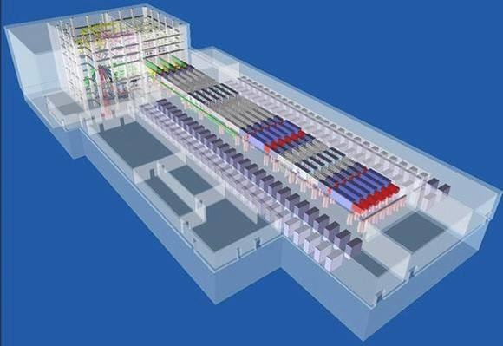
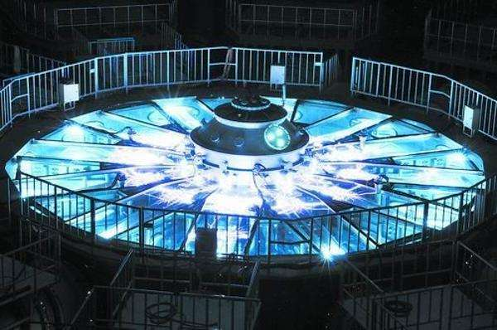

Slide 24
显示、指示
3D显示、全息
激光电视
激光笔、

Slide 25
生物、医疗
optogenetics
诊断：体外诊断、研究（细胞、分子、血液激光）
治疗：近视、手术（切割、热熔）

Slide 26
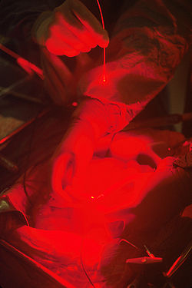
Laser radiation being delivered, via a fiber, for photodynamic therapy to treat cancer.

Slide 27
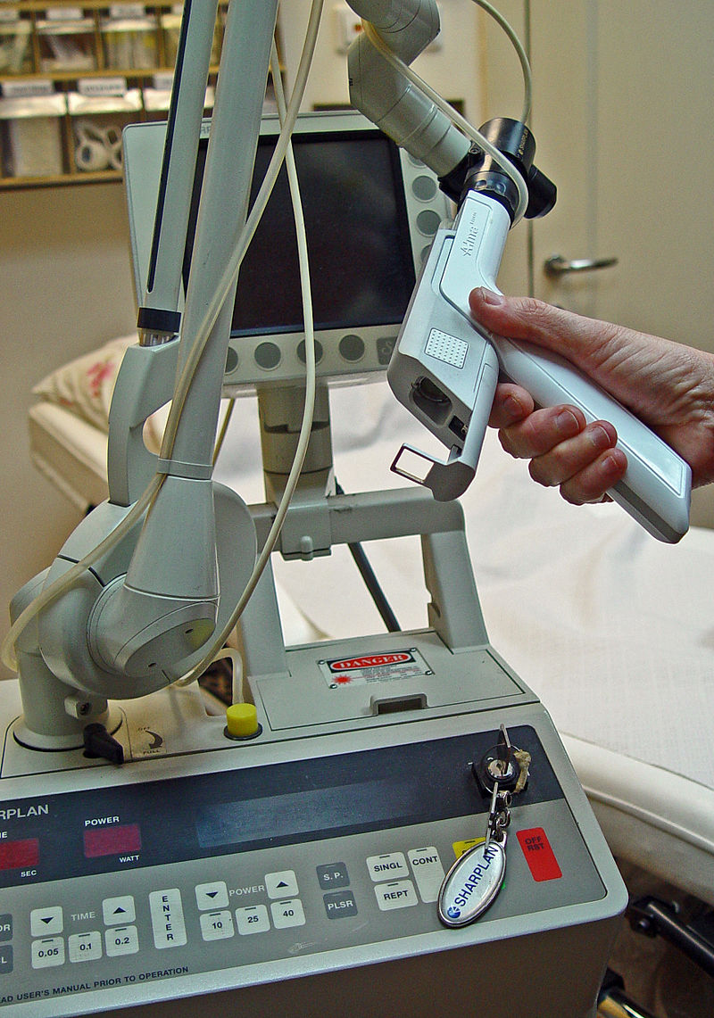
40 watt CO₂ laser with applications in ENT, dermatology, oral surgery, and podiatry

